Slide 1

Analysis of Algorithms
Rem Collier
Room A1.02
School of Computer Science and Informatics
University College Dublin, Ireland

Slide 2
Overview
Experimental approaches to evaluating algorithms have several limitations:
  Algorithm must be implemented
  Limited Set of Inputs
  Data Set Selection Non-trivial
  Must use same hardware and software environments.
  No guarantee that the algorithm will work in the same way when “live”.
In some application domains, this is not enough.
  For example, routing algorithms for Air Traffic Control Systems.
We need guarantees of what will happen in the worse case…

Slide 3
Recap: Pseudo Code
Typically, pseudo code combines the following features:
  Operator support for expressions: + - * / % & | ! = < > <= >= <>.
  An assignment operator: ←.
  If statements: if … then … [else…]
  While loops: while … do …
  For loops: for … to … do …
  Repeat loops: repeat … until … (like do…while … loops in Java)
  Array indexing: A[i]
  Method Declarations: Algorithm algorithmName(param1, …)
  Procedure Calls: algorithmName(param1,…)
  Returns: return …
In fact, we can include any other feature we want into our language, so long as we explain what it does (not how it does it).
  E.g. Console Printing: print(…)

Slide 4
Pseudo Code Analysis
Treat a computer as if it is a coin operated device.
  $1 gets you a fixed amount of processing time.
Identify a set of primitive operations.
  Charge $1 for each operation
Count the number of primitive operations
  Consider only the worst case
Now we have a generic “value” for the cost of the algorithm.
  Running time is proportional to the cost of the algorithm.

Slide 5
What Primitive Operations?
Assigning a value to a variable
Calling a procedure
Performing an arithmetic operation
Comparing two values
Indexing into an array
Returning from a method

Slide 6
Example: Minimum Value
Algorithm MinValue(a, b):
Input: Two integer numbers a and b
Output: The smaller of a and b
if a < b then
return a
else
return b

Slide 7
Example: Sum Array
Algorithm SumArray(A, n):
Input: An integer array A of size n.
Output: The Sum of the values in A.
sum ← 0
for k=0 to n-1 do
sum ← sum + A[k]
return sum

Slide 8
Sum Array Operation Counting
<algorithm cost>
= <cost of assignment>+ <cost of loop> + <cost of return>
= 1 + <cost of loop> + 1
<cost of loop>
= <cost of initial assignment> + <cost of guard> +
( <cost of guard> + <cost of increment> +
<cost of inner statements> ) * <number of iterations>
= 1 + 2 + (2 + 2 + 3) * n
= 3 + 7n
So,
<algorithm cost>
= 1 + <cost of loop> + 1 = 1 + 7n + 3 + 1 = 7n + 5

Slide 9
Example: Max Array
Algorithm MaxArray(A, n):
Input: An integer array A of size n.
Output: The maximum value in A.
currentMax ← A[0]
for k=1 to n-1 do
if (currentMax < A[k]) then
currentMax ← A[k]
return currentMax

Slide 10
Max Array Operation Counting
<algorithm cost>
= <cost of assignment>+ <cost of loop> + <cost of return>
= 1 + <cost of loop> + 1
<cost of loop>
= <cost of initial assignment> + <cost of guard> +
( <cost of guard> + <cost of increment> +
<cost of inner statements> ) * <number of iterations>
= 1 + 2 + (2 + 2 + 4) * (n-1)
= 3 + 8n – 8 = 8n - 5
So,
<algorithm cost>
= 1 + <cost of loop> + 1 = 1 + 8n - 5 + 1 = 8n - 3

Slide 11
Discussion
We can simplify the analysis by considering only the loop contents (ignoring the costs of the loop: variable initialization, checking the guard, the increment):
  Operations in for-loop: 4
  Number of iterations: n-1
  Total operations: 4(n-1) = 4n - 4
In reality, what we are doing here is viewing the loop in terms of a summation of the contents of the loop, i.e.:
total operations = 4 + 4 + … + 4 (done n-1 times)
Mathematics has a neat way of representing this…

Slide 12


Summation (from Wikipedia)
Mathematics has a special notation for compactly representing the summation of similar terms:
For example:
URL: http://en.wikipedia.org/wiki/Summation

Slide 13
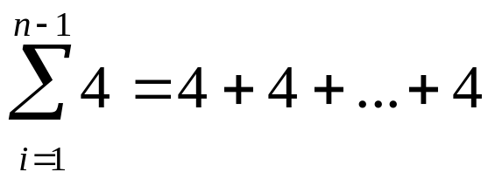
Discussion
So, we can represent the loop from the previous example as follows:
But, why do this? we already worked out the answer…

Slide 14


Summation Identities
An identity is an equality that remains true regardless of the values of any variables that appear within it.
There are many summation identities, but for this course, the following are very useful:
  Identity 1:
  Identity 2:

Slide 15
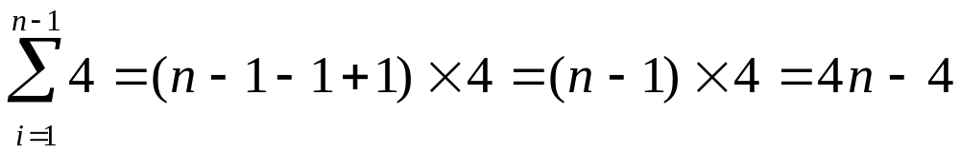
Discussion
So, if we know the range, and can write the loop as a summation…
Then, we can use identity 1 to immediately get an answer…

Slide 16
Example: Factorial
Algorithm Factorial(a):
Input: An integer a
Output: The value of a factorial (a!)
factorial ← 1
for k=1 to a do
factorial ← factorial * k
return factorial

Slide 17
Factorial Operation Counting
<algorithm cost>
= <cost of assignment>+ <cost of loop> + <cost of return>
= 1 + <cost of loop> + 1
<cost of loop>
= <cost of initial assignment> + <cost of guard> +
( <cost of guard> + <cost of increment> +
<cost of inner statements> ) * <number of iterations>
= 1 + 1 + (1 + 2 + 2) * a
= 2 + 5a
So,
<algorithm cost>
= 1 + <cost of loop> + 1 = 1 + 2 + 5a + 1 = 5a + 4

Slide 18
Example: Power
Algorithm Power(a, b):
Input: Two integers a and b
Output: The value of a to the power b
power ← 1
for k=1 to b do
power ← power * a
return power

Slide 19
Power Operation Counting
<algorithm cost>
= <cost of assignment>+ <cost of loop> + <cost of return>
= 1 + <cost of loop> + 1
<cost of loop>
= <cost of initial assignment> + <cost of guard> +
( <cost of guard> + <cost of increment> +
<cost of inner statements> ) * <number of iterations>
= 1 + 1 + (1 + 2 + 2) * b
= 2 + 5b
So,
<algorithm cost>
= 1 + <cost of loop> + 1 = 1 + 2 + 5b + 1 = 5b + 4

Slide 20
Example: Bubble Sort
Algorithm BubbleSort(A, n):
Input: An integer array A of size n.
Output: A is sorted in ascending order
for j=n-1 to 1 do
for k=0 to j-1 do
if (A[k] > A[k+1]) then
temp ← A[k]
A[k] ← A[k+1]
A[k+1] ← temp
return A

Slide 21
Bubble Sort Operation Counting
<inner loop cost> = <cost of initial assignment> + <cost of guard> +
( <cost of inner statements> +
<cost of guard> +
<cost of increment>
) * <number of iterations>
= 1+2 + (13 + 2 + 2) * j = 17j + 3
With the outer loop, there is a problem that the inner loop costs vary based on the value of the counter for the outer loop, so we rewrite the loop calculation as:
<outer loop cost> = <cost of initial assignment> + <cost of guard> +
( <cost of increment> +
<cost of guard> +
) * <number of iterations> + <total cost of inner loop>

Slide 22
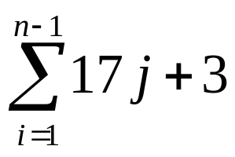
Bubble Sort Operation Counting
The key problem here is to calculate <total cost of inner loop>. We must do this differently because the inner loop cost depends on the value of j – we can use the summation calculation described earlier:
<total cost of inner loop> =
(by identity 2) = 17*(n-1-1+1)(n-1+1)/2 + (n-1-1+1)*3
= 17(n-1)n/2 + 3n-3
So,
<outer loop cost> = 2 + 1 + (2 + 1)*(n-1) + <total cost of inner loop>
= 3 + 3n – 3 + 17(n²-n)/2 + 3n – 3
= 17n²/2 +6n – 17n/2 – 3
= 17n²/2 -5n/2 - 3

Slide 23
Asymptotic Analysis
Sometimes, we want to present a reasonable approximation of the performance of an algorithm.
One approach to doing this is to employ asymptotic notation.
  This approach aims to simplify analysis by getting rid of unneeded information.
  A good analogy is rounding of numbers (e.g. 1,000,001≈1,000,000)
Basically, what we want to be able to say is something like:
  prefixAverages1(…) has ≈ n² operations
  prefixAverages2(…) has ≈ n operations
For this, we use “Big-Oh” Notation…

Slide 24
“Big-Oh” Notation
Given functions f(n) and g(n), we say that
f(n) is O(g(n)) if and only if
there are positive constants c and n₀ such that
f(n) ≤ c * g(n) for all n ≥ n₀

Slide 25
Example
Consider an algorithm with running time 11n + 5.
  f(n) = 11n + 5
If we can show that g(n) = n satisfies the constraint:
  f(n) ≤ c * g(n) for all n ≥ n₀
Then, we can prove that 11n + 5 is O(n):
So, lets consider c = 12:
  11n + 5 ≤ 12n
  5 ≤ 12n - 11n
  5 ≤ n
Therefore, f(n) ≤ 12 * g(n) for all n ≥ 5

Slide 26
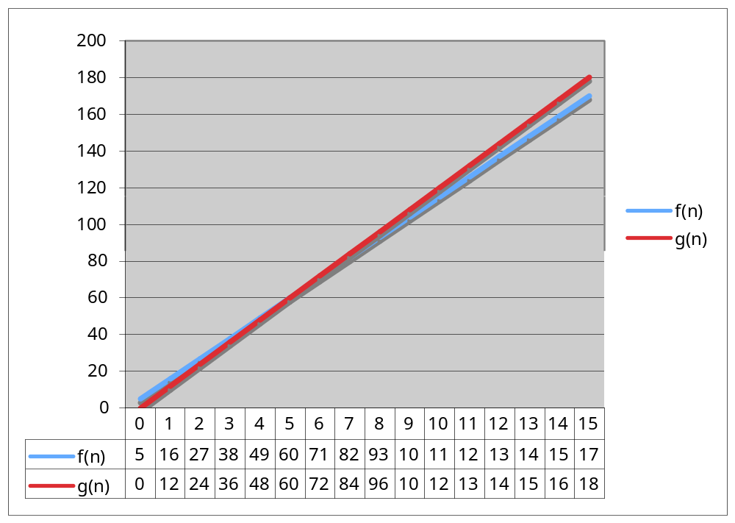
Example

Slide 27
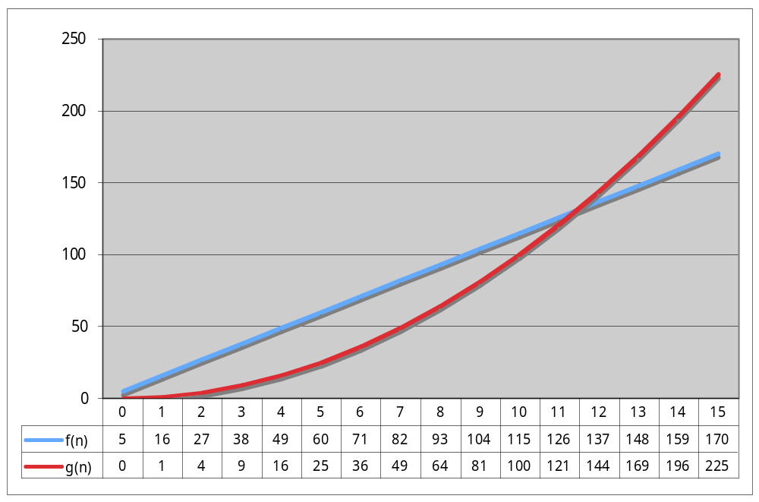
Using “Big-Oh” Notation
Basically, when we choose g(n), we can choose any function that we want.
  For example, consider: f(n) = 11n + 5, g(n) = n², c = 1, n₀ = 12
However, while it is correct to say that “11n + 5 is O(n²)”, it is not a good approximation.

Slide 28
Using “Big-Oh” Notation
We consider an approximation to be good if it is similar to the actual function, but does not include lower order terms.
This is because, what we are really interested in is being able to classify algorithm performance.
  logarithmic: O(log n)
  linear: O(n)
  quadratic: O(n²)
  polynomial: O(n^{k}), k ≥ 1
  exponential: O(a^{n}), n > 1
Simple Rule: Drop lower order terms and constant factors:
  11n + 5 is O(n)
  8n²log n + 5n2 + n is O(n²log n)

Slide 29
Using “Big-Oh” Notation
Once we have our approximation, we can easily compare running times:
  an algorithm that runs in O(n) time is better than one that runs in O(n²) time
  similarly, O(log n) is better than O(n)
Basically, there is a hierarchy of functions:
  log n << n << n² << n³ << 2^{n}
Caution! Beware of very large constant factors.
  An algorithm with running-time 1,000,000 n is still O(n) but might be less efficient on your data set than one with running-time 2n², which is O(n²).
  Remember “Big-Oh” only works for values of n greater than or equal to some constant value.

Slide 30
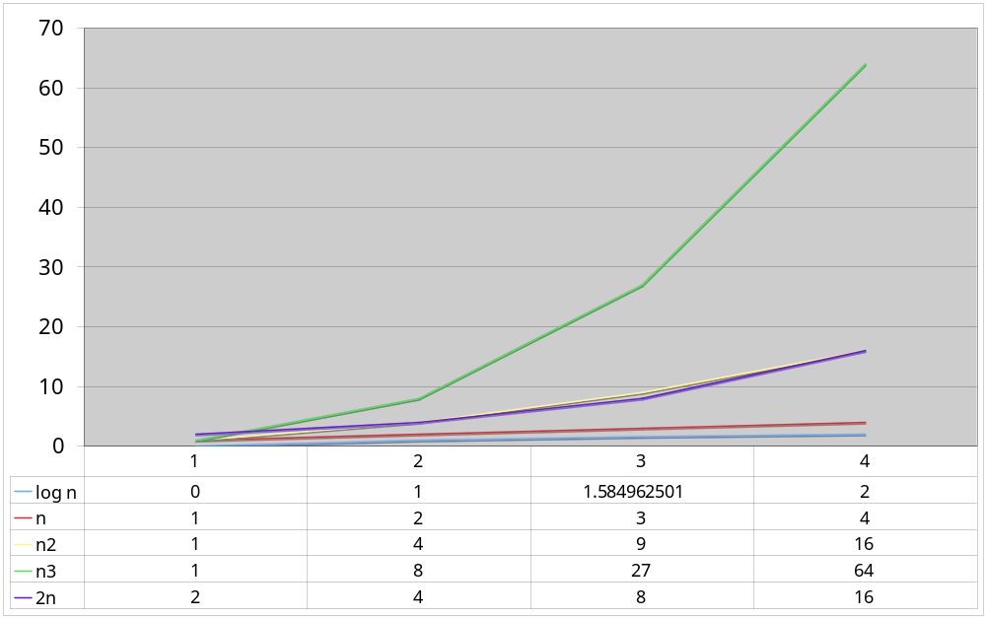
Using “Big-Oh” Notation

Slide 31
Some Basic Maths
properties of logarithms:
  log(xy) = log(x) + log(y)
  log(x/y) = log(x) - log(y)
  log(xa) = alog(x)
properties of exponentials:
  a^{(b+c)} = a^{b}a^{c}
  a^{bc} = (a^{b})^{c}
  a^{b}/a^{c} = a^{(b-c)}
  b = a ^{loga(b)}
  b^{c} = a^{c*loga(b)}
Floor: ⎣x⎦ = the largest integer ≤ x
Ceiling: ⎡x⎤ = the smallest integer ≥ x

